Slide 1
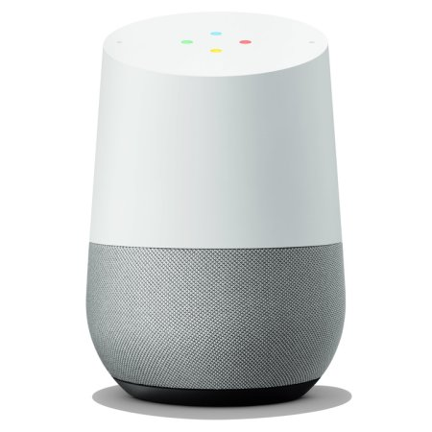
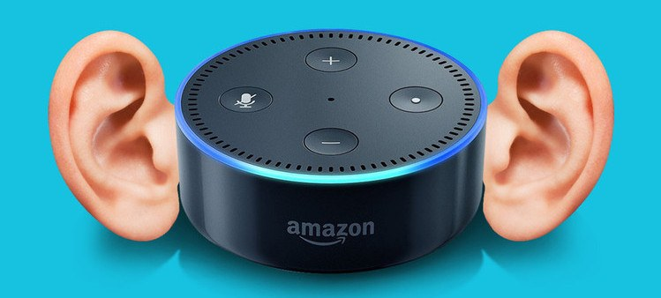
How Much Do Google Home and Alexa Really Hear?
Lauren Holt

Slide 2
Always-On Microphones
Devices like Amazon Echo and Google Home incorporate always on microphones to allow for verbal interaction with the user
Devices are designed to detect only your chosen wake word (“Hey Google” or “Alexa”)
The device detects the wake word by identifying acoustic patterns that match the wake word. No audio is stored or sent to the cloud unless the device detects the wake word

Slide 3
The Recordings
Following the wake word detection, the audio is streamed to the cloud to be transcribed into text and then returns to the device
The audio is saved and used to improve the personalization of your experience with the smart speaker, adjusting to things from the way you talk to your music taste
The company also uses the audio to improve the speech recognition and natural language understanding systems in the devices in general

Slide 4
The Future
Though marketing targeted data collection goes against current privacy policies, the rise of always-on microphones creates many unknowns in the future
A report created by the consumer advocacy group, Consumer Watchdog, revealed that
Amazon has filed a patent application for an algorithm that would let future versions of the device identify statements of interest, such as 'I love skiing', enabling the speaker to be monitored based on their interests and targeted for related advertising.
A Google patent application describes using a future release of it smart Home system to monitor and control everything from screen time and hygiene habits, to meal and travel schedules and other activities.
Patents take multiple years to receive and do not necessarily reflect current developments to products and services.'
Further research: Misinterpreting sounds as wake words and recording private convo and case studies where conversations were wrongfully recorded/sent to someone

